Slide 1
TCP/IP by Rukhsar Khureshi

Slide 2
Protocols
Communication between two people or two devices needs to follow some protocol. A protocol is a set of rules that governs communication.
For example, in a face-to-face communication between two persons, there is a set of implicit rules in each culture that define how two persons should start the communication, how to continue the communication, and how to end the communication.
A protocol defines what is communicated, how it is communicated and when it is communicated. The key elements of a protocol are syntax, semantics, and timing.

Slide 3
Syntax. Syntax refers to the structure or format of the data, meaning the order in which they are presented. For example, a simple protocol might expect the first 8 bits of data to be the address of the sender, the second 8 bits to be the address of the receiver, and the rest of the stream to be the message itself.
Semantics. Semantics refers to the meaning of each section of bits. How is a particular pattern to be interpreted, and what action is to be taken based on that interpretation? For example, does an address identify the route to be taken or the final destination of the message?
Timing. Timing refers to two characteristics: when data should be sent and how fast it can be sent. For example, if a sender produces data at 100 megabits per second (100 Mbps) but the receiver can process data at only 1 Mbps, the transmission will overload the receiver and data will be largely lost.

Slide 4
The OSI Model and
TCP/IP
Protocol Suite

Slide 5
CONTENTS
THE OSI MODEL
LAYERS IN THE OSI MODEL
TCP/IP PROTOCOL SUITE
ADDRESSING
TCP/IP VERSIONS

Slide 6

Simple Communication

Slide 7
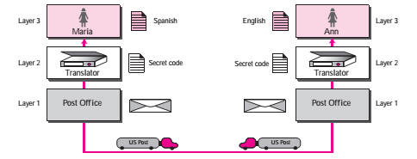
Not so Simple

Slide 8
2.1
THE
OSI
MODEL

Slide 9
An open system is a set of protocols that allows any 2 different systems to communicate regardless of their underlying architecture.

Slide 10

ISO is the organization. OSI is the model.

Slide 11
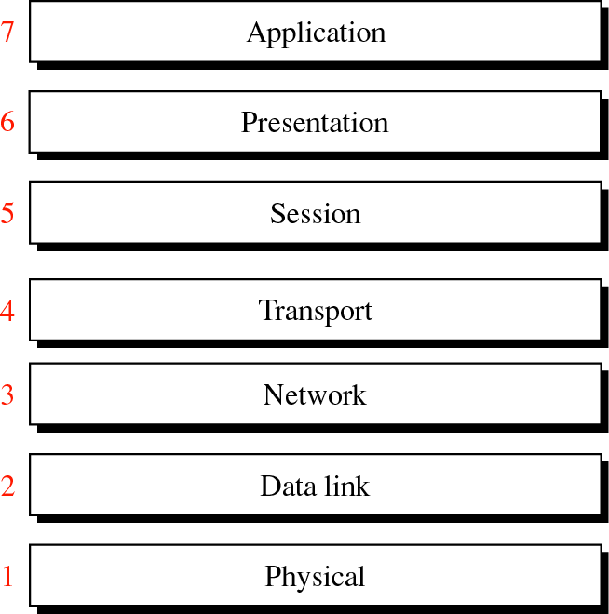
Figure 2-1
OSI Model

Slide 12
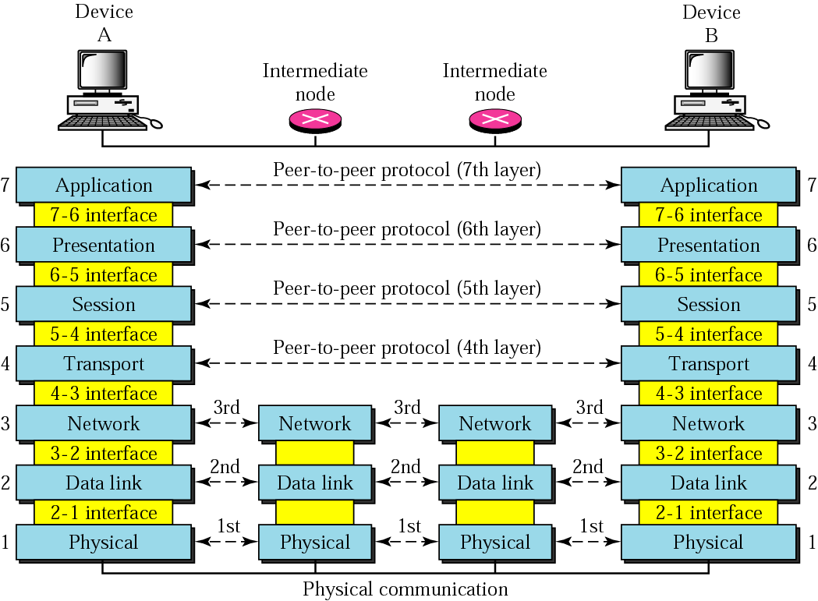
Figure 2-2
OSI layers

Slide 13
functions had related uses and collected those functions into discrete groups that became the layers.
Each layer defines a family of functions distinct from those of the other layers.
Each layer calls upon the services of the layer just below it.
Layer 2 layer3 layer4

Slide 14
Organization of the Layers
Three subgroups
Layers 1, 2, and 3
Network support layers
Deal with the physical aspects of moving data from one device to another
Electrical specifications, physical connections, physical addressing, and transport timing and reliability

Slide 15
Layers 5, 6, and 7 -User support layers.
-Allow interoperability among unrelated software systems.
Layer 4
- Links the two subgroups - Ensures that what the lower layers have transmitted in a form that the upper layers can use

Slide 16
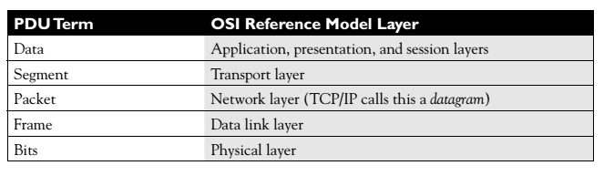
Encapsulation and De-encapsulation
Each layer adds information to the original data – Encapsulation
protocol data unit (PDU)

Slide 17
To physical layer - Once the physical layer is reached, the bits of the data link layer frame are converted into a physical layer signal—a voltage, light source, radio wave
De-encapsulation- stripping off the headers and trailers of the PDU

Slide 18
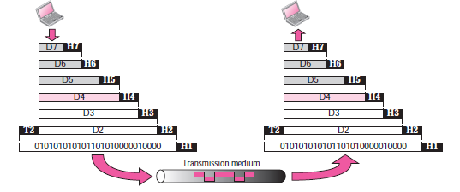
Figure 2-3
An exchange using the OSI model

Slide 19
2.2
LAYERS
IN
THE
OSI
MODEL

Slide 20
Physical Layer
Coordinates the functions required to carry a bit stream over a physical medium.
Deals with Mechanical and electrical specifications of the interface and transmission media.
Also defines procedures and functions that physical devices and interfaces have to perform for transmission to occur.

Slide 21
Physical layer is concerned with the foll:
Physical characteristics of interfaces and media.
Representation of bits. - encoding (how 0s and 1s are changed to signals).
Data rate.
Synchronization of bits
Line configuration.- P2P, Multipoint
Physical topology.
Transmission mode

Slide 22
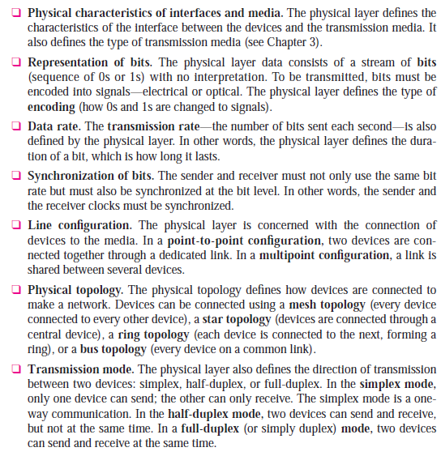

Slide 23
Data Link Layer
Transforms the physical layer, a raw transmission facility, to a reliable link.
Makes the physical layer appear error-free to the upper layer.
Other responsibilities:
Framing.
Physical addressing.
Flow control.
Error control.
Access control.

Slide 24
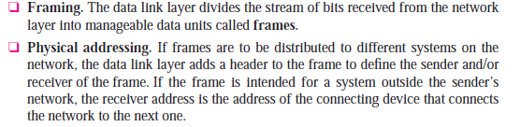

Slide 25
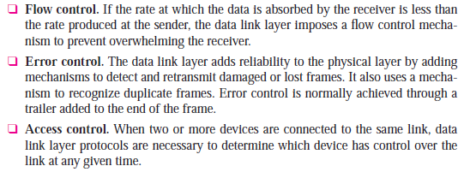

Slide 26

Note:
The data link layer is responsible for moving frames from one hop (node) to the next.

Slide 27
Network Layer
Source-to-destination delivery of a packet across networks.
Logical addressing.
Routing.

Slide 28
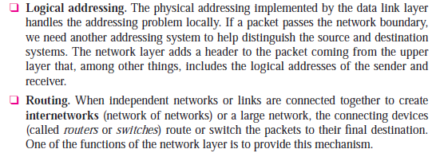

Slide 29
Transport Layer
The transport layer is responsible for process-to-process delivery of the entire message.
Service-point addressing (port addressing).
Segmentation and reassembly – sequence numbers
Connection control.- Connection Oriented & connectionless
Flow control.
Error control.

Slide 30
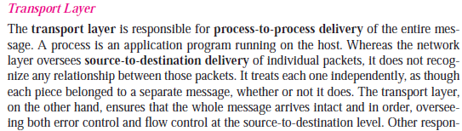

Slide 31
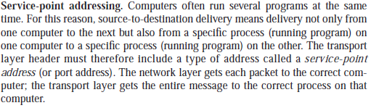

Slide 32
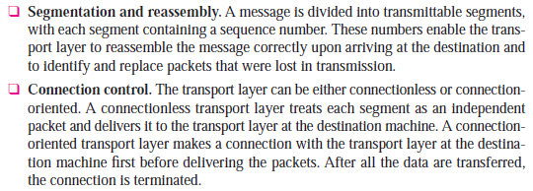

Slide 33
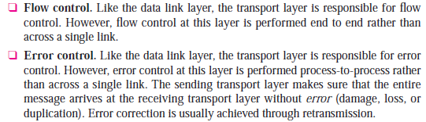

Slide 34
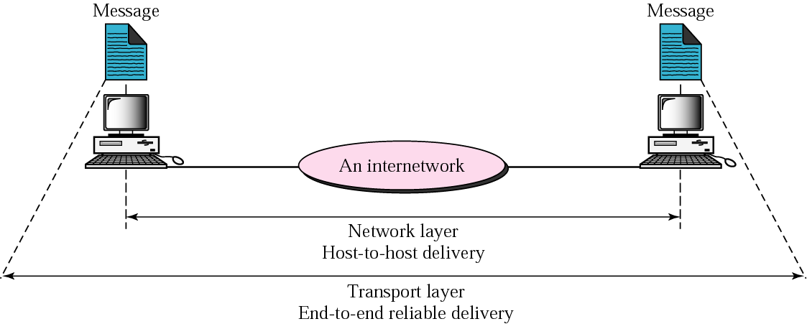
Figure 2-10
Reliable end-to-end delivery of a message

Slide 35
Session Layer
Session layer is the network dialog controller.
-establishes, maintains, and synchronizes the interaction between communicating systems.
Dialog control
- half duplex or full-duplex
Synchronization.
Check Points [2000 pages as group of 100]

Slide 36


Slide 37
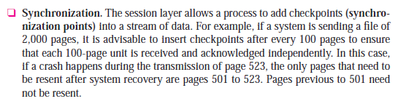

Slide 38
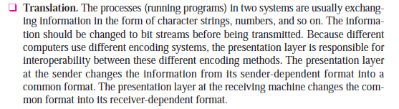
Presentation Layer
Concerned with Syntax and semantics of the info exchanged between 2 systems.

Slide 39
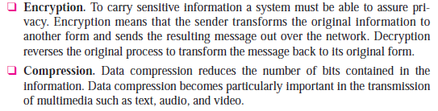

Slide 40

Application layer

Slide 41
Application Layer
Network virtual terminal.
File transfer, access, and management (FTAM).
E-mail services.
Directory services.

Slide 42
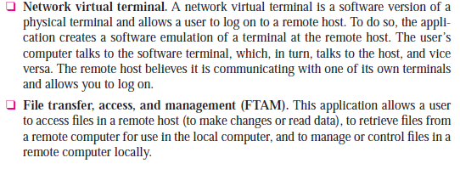

Slide 43


Slide 44
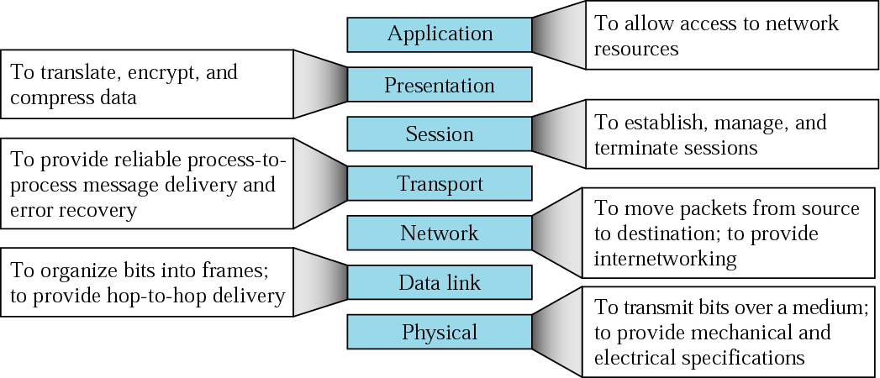
Figure 2-14
Summary of layers

Slide 45
BOOTP, DHCP, DNS, FTP, HTTP, HTTPS, IMAP4, PING, POP3, NSLOOKUP, NTP, SFTP, SMTP, Telnet, TFTP | Application Layer Protocols
MIME, SSL, TLS | Presentation Layer Protocols
RTP, SIP | Session Layer Protocols
TCP, UDP | Transport Layer Protocols

Slide 46
ARP, ICMP, IGMP, IP, IPSec, RARP | Network Layer Protocols
L2TP, PPP, PPTP, SLIP | Data Link Layer Protocols
IEEE 802.3 (Ethernet) 802.5 (Token Ring) 802.11 (Wi-Fi) | Physical Layer Protocols

Slide 47
TCP/IP
PROTOCOL
SUITE

Slide 48
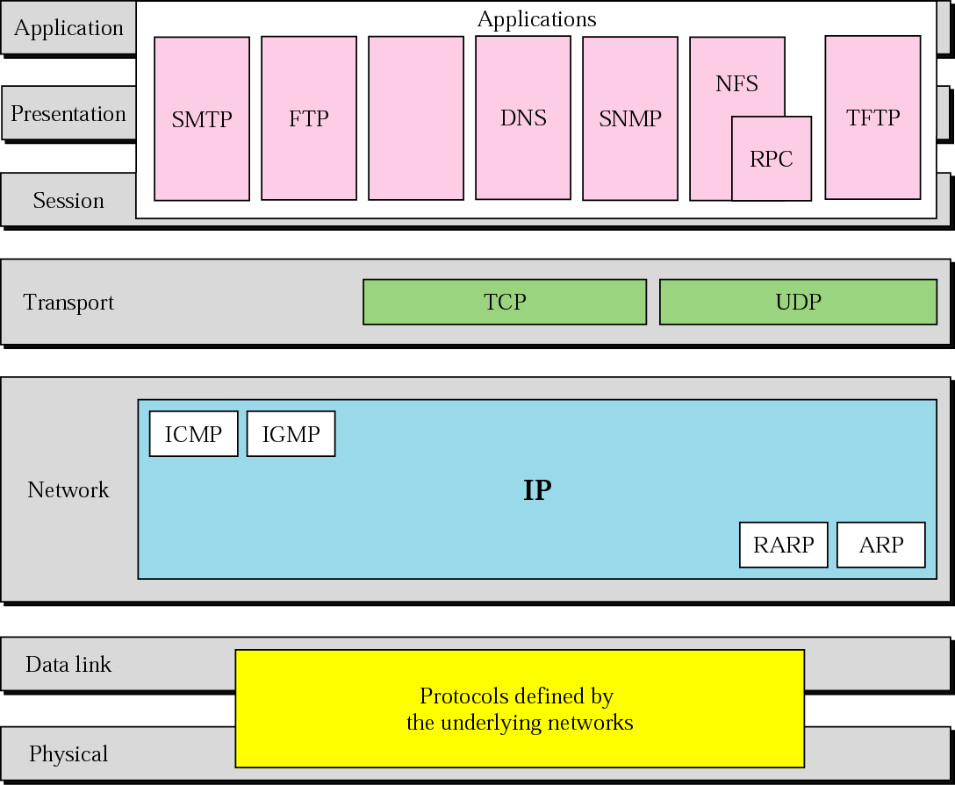
Figure 2-15
TCP/IP and OSI model

Slide 49
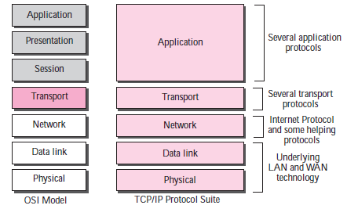

Slide 50
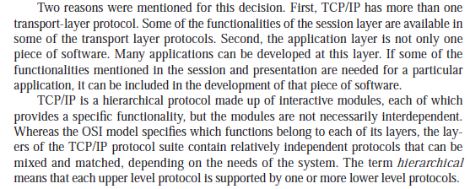

Slide 51
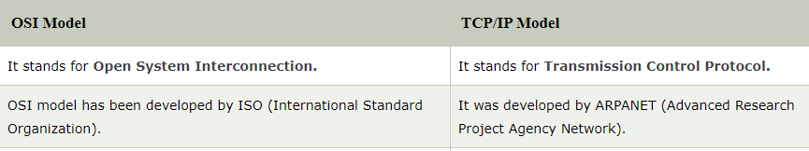

Slide 52
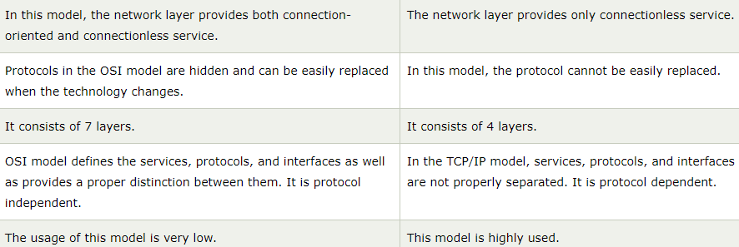

Slide 53
2.4
ADDRESSING

Slide 54
Figure 2-16
Addresses in TCP/IP

Slide 55
Addresses in tcp/ip
Physical addresses (link address)
Logical address
Port address

Slide 56
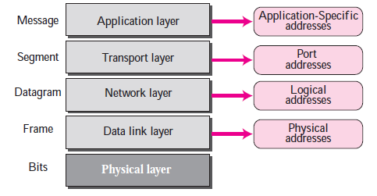

Slide 57
Example 1
Figure 2.18 shows an example of physical addresses.

Slide 58
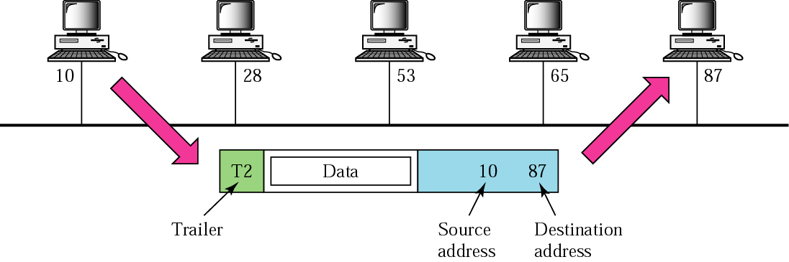
Figure 2-18
Physical addresses
Packet dropped
87 10
data
adestination
Destination source

Slide 59
Example 2
Most local area networks use a 48-bit (6 bytes) physical address written as 12 hexadecimal digits, with every 2 bytes separated by a hyphen as shown below:
07-01-02-01-2C-4B
A 6-byte (12 hexadecimal digits) physical address

Slide 60
Example 3
Figure 2.19 shows an example of Internet addresses (32 bit).
Physical address changes from hop to hop but logical address remains the same.

Slide 61
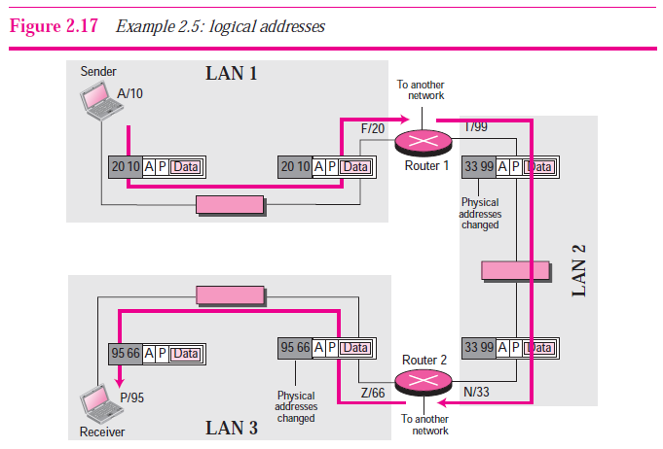
Nos are phy.add and alphabets represent logical address

Slide 62
Example 4
As we will see in Chapter 4, an Internet address (in IPv4) is 32 bits in length, normally written as four decimal numbers, with each number representing 1 byte. The numbers are separated by a dot. Below is an example of such an address.
132.24.75.9

Slide 63
Port address
Today, computers are devices that can run multiple processes at the same time. The end objective of Internet communication is a process communicating with another process.
For example, computer A can communicate with computer C by using TELNET. At the same time, computer A communicates with computer B by using the File Transfer Protocol (FTP).
For these processes to receive data simultaneously, we need a method to label the different processes. In other words, they need addresses. In the TCP/IP architecture, the label assigned to a process is called a port address. A port address in TCP/IP is 16 bits in length.

Slide 64
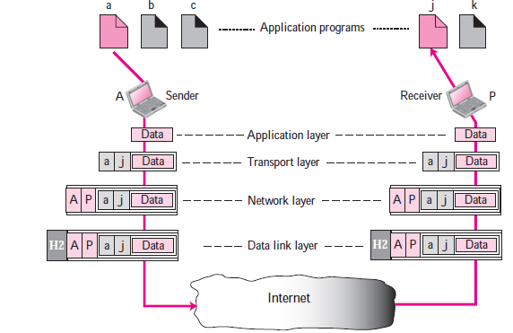

Slide 65
Example 6
As we will see in Chapters 11 and 12, a port address is a 16-bit address represented by one decimal number as shown below.
753 A 16-bit port address

Slide 66
2.5
TCP/IP
VERSIONS

Slide 67
Versions:
Version 4 (current)

Slide 68
Connecting devices
We discuss three kinds of connecting devices: repeaters or hubs, bridges or two-layer switches, and routers or three-layer switches. Repeaters and hubs operate in the first layer of the Internet model. Bridges and two-layer switches operate in the first two layers. Routers and three-layer switches operate in the first three layers.

Slide 69
A Layer 2 switch only works with MAC addresses and doesn't interact with any higher layer addresses, such as an IP.
A Layer 3 switch, on the other hand, can also do static routing and dynamic routing, which includes IP and virtual local area network (VLAN) communications

Slide 70
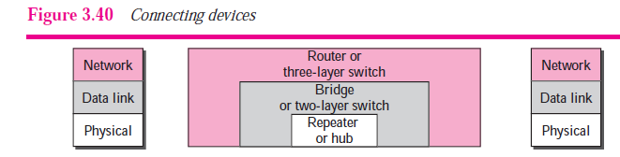

Slide 71
Connecting devices
1. Repeater – A repeater operates at the physical layer. Its job is to regenerate the signal over the same network before the signal becomes too weak or corrupted so as to extend the length to which the signal can be transmitted over the same network. An important point to be noted about repeaters is that they do no amplify the signal. When the signal becomes weak, they copy the signal bit by bit and regenerate it at the original strength. It is a 2 port device.

Slide 72
2. Hub – A hub is basically a multiport repeater. A hub connects multiple wires coming from different branches, for example, the connector in star topology which connects different stations. Hubs cannot filter data, so data packets are sent to all connected devices. In other words, collision domain of all hosts connected through Hub remains one. Also, they do not have intelligence to find out best path for data packets which leads to inefficiencies and wastage.

Slide 73
3. Bridge – A bridge operates at data link layer. A bridge is a repeater, with add on functionality of filtering content by reading the MAC addresses of source and destination.
It is also used for interconnecting two LANs working on the same protocol. It has a single input and single output port, thus making it a 2 port device.

Slide 74
4. Switch – A switch is a multi port bridge with a buffer and a design that can boost its efficiency(large number of ports imply less traffic) and performance. Switch is data link layer device. Switch can perform error checking before forwarding data, that makes it very efficient as it does not forward packets that have errors and forward good packets selectively to correct port only. In other words, switch divides collision domain of hosts, but broadcast domain remains same.

Slide 75
5. Routers – A router is a device like a switch that routes data packets based on their IP addresses. Router is mainly a Network Layer device. Routers normally connect LANs and WANs together and have a dynamically updating routing table based on which they make decisions on routing the data packets. Router divide broadcast domains of hosts connected through it.

Slide 76
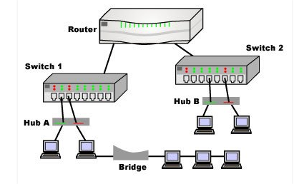

Slide 77
6. Gateway – A gateway, as the name suggests, is a passage to connect two networks together that may work upon different networking models. They basically works as the messenger agents that take data from one system, interpret it, and transfer it to another system. Gateways are also called protocol converters and can operate at any network layer. Gateways are generally more complex than switch or router.

Slide 78
vlans
A VLAN is a group of devices on one or more LANs that are configured to communicate as if they were attached to the same wire, when in fact they are located on a number of different LAN segments. Because VLANs are based on logical instead of physical connections, they are extremely flexible.

Slide 79
VLANs can help reduce IT cost, improve network security and performance, provide easier management, as well as ensuring network flexibility.

Slide 80
Lan 1
Lan 2
Lan 3
vlan

Slide 81
Static and Dynamic VLANs
Network administrators often refer to static VLANs as “port-based VLANs.” A static VLAN requires an administrator to assign individual ports on the network switch to a virtual network. No matter what device is plugged into that port, it becomes a member of that same pre-assigned virtual network.

Slide 82
Dynamic VLAN configuration allows an administrator to define network membership according to characteristics of the devices themselves rather than their switch port location.
For example, a dynamic VLAN can be defined with a list of physical addresses (MACaddresses) or network account names.

Slide 83
Setting up a VLAN
At a high level, network administrators set up new VLANs as follows:
Choose a valid VLAN number
Choose a private IP address range for devices on that VLAN to use

Slide 84
Configure the switch device with either static or dynamic settings.
Static configurations require the administrator to assign a VLAN number to each switch port while dynamic configurations require assigning a list of MAC addresses or user names to a VLAN number.
Configure routing between VLANs as needed. Configuring two or more VLANs to communicate with each other requires the use of a VLAN-aware router.

